Slide 1

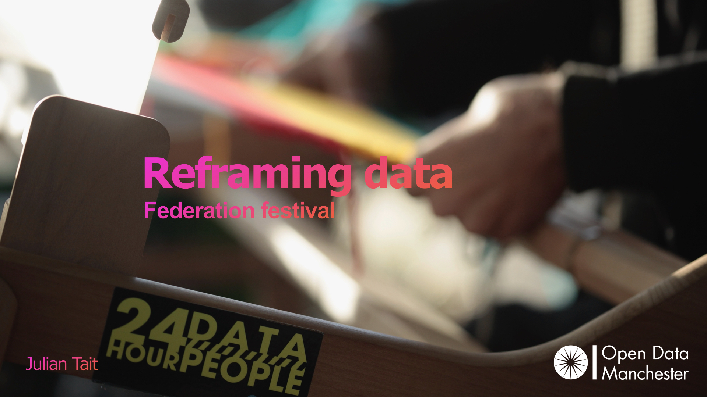

What is a data centre anyway?
8th October 2026 - Dr Kirsty Styles

Slide 2
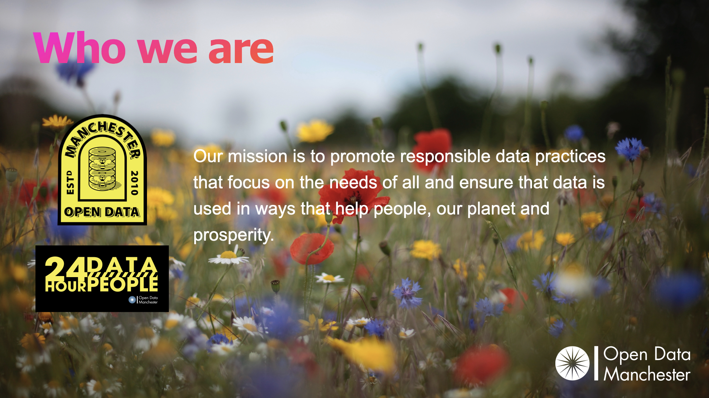

Slide 3

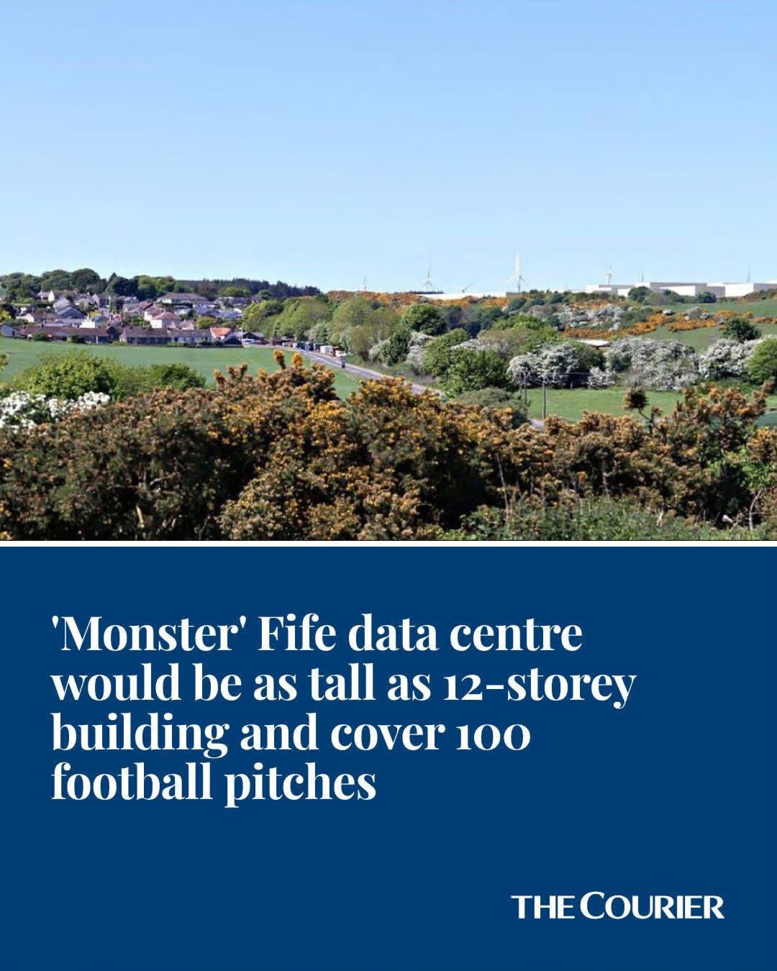



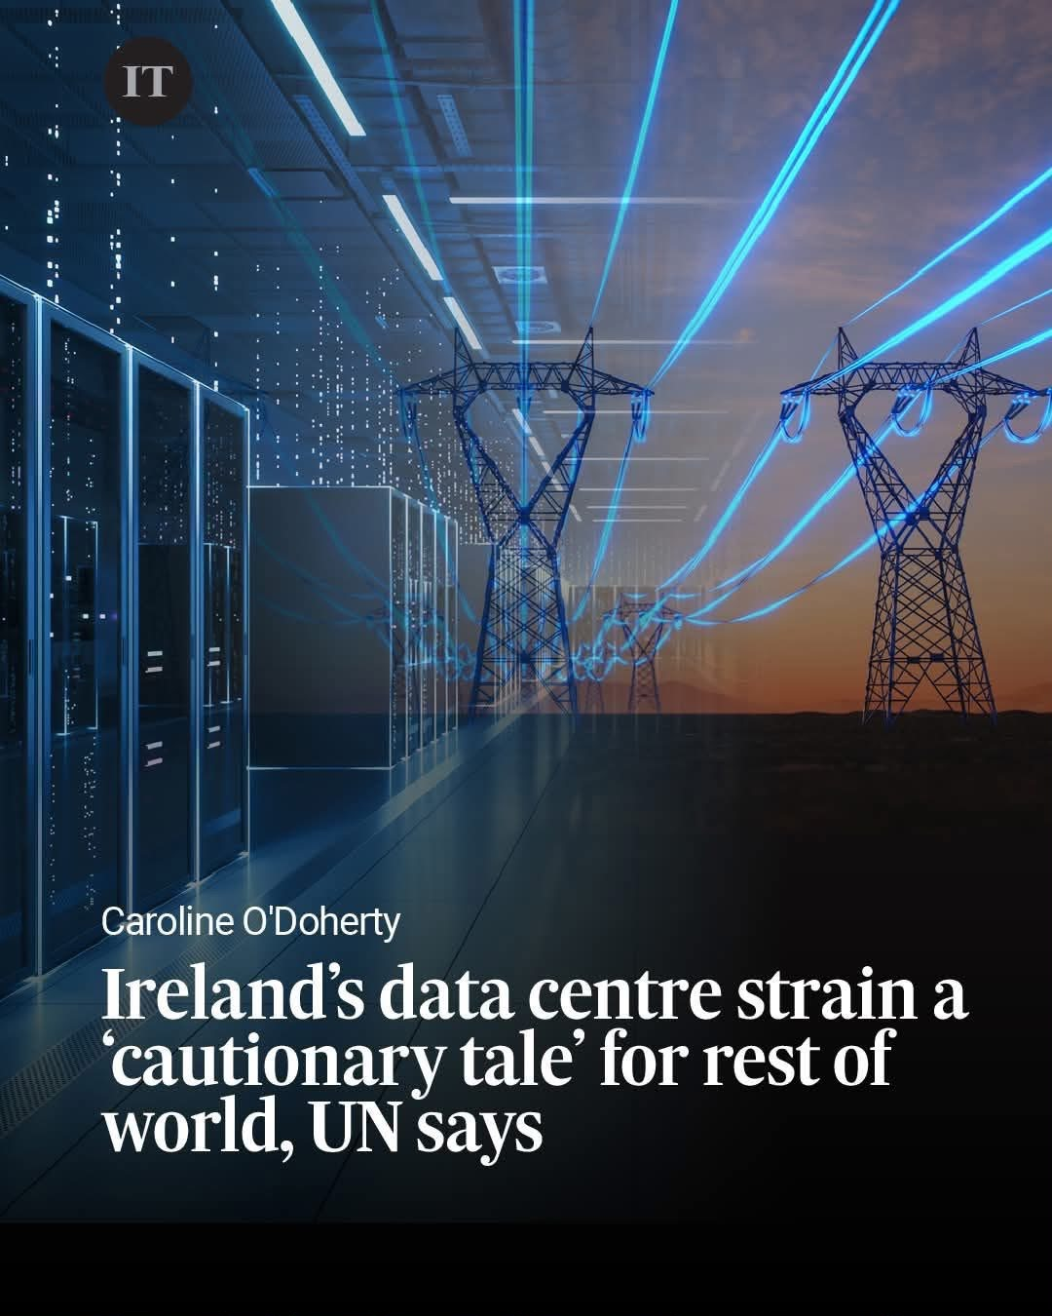
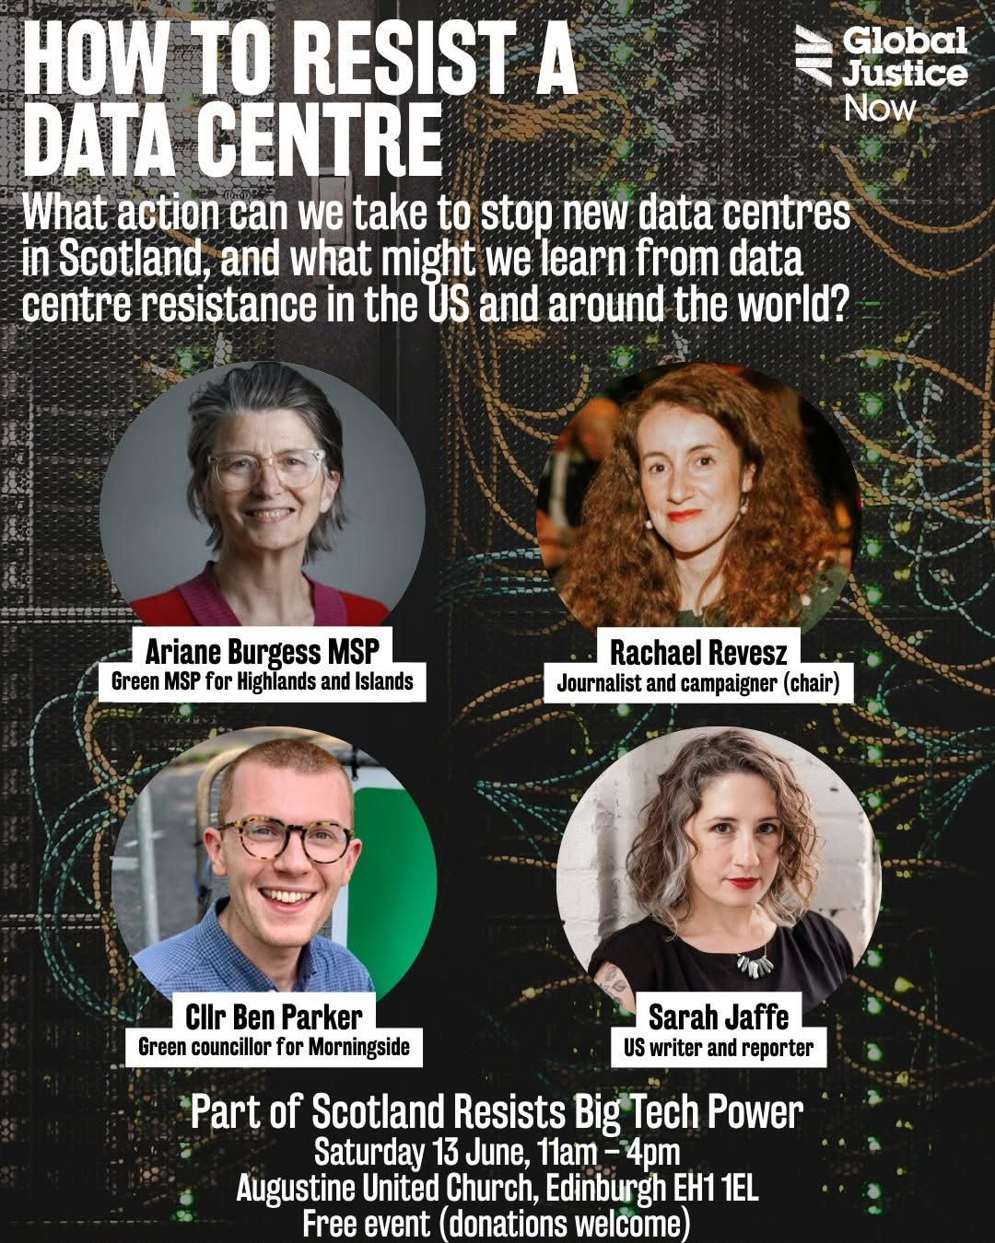

Notes:
Ethical AI Companies, Ethical Consumer (3 June 2026) https://www.ethicalconsumer.org/technology/shopping-guide/ethical-ai-companies-llms
Fife data centre height would be same as a 12-storey building, The Courier, DC Thomson (6 June 2026) https://www.thecourier.co.uk/fp/news/fife/5506416/fife-data-centre-height-12-storey-building/
Can floating data centres meet AI's huge energy demand?, New Scientist (25 May 2026) https://www.facebook.com/newscientist/videos/can-floating-data-centres-meet-ais-huge-energy-demandthe-data-centres-powering-t/26765353333134619/
Google rents SpaceX/AI supercomputers for $920M a month, ahead of IPO, Euronews (6 June 2026) https://www.euronews.com/business/2026/06/06/google-rents-spacexai-supercomputers-for-920m-a-month-ahead-of-ipo
If Data Centers Are So Great, Why Are They Being Built in Secret?, The Brockovich Report, Brockovich AI Data Center Reporting (27 May 2026) https://www.thebrockovichreport.com/p/if-data-centers-are-so-great-why
Ireland’s data centre strain a ‘cautionary tale’ for rest of world, UN says, The Irish Times (3 June 2026) https://www.irishtimes.com/ireland/2026/06/03/irelands-data-centre-strain-a-cautionary-tale-for-rest-of-world-un-says/
How to resist a data centre [event], Global Justice Now (13 June 2026): event in Scotland with Nick Dearden, director of Global Justice Now, Samer Abdelnour, Senior Lecturer at the University of Edinburgh, Craig Dalzell, head of policy and research at Common Weal, and Rachel Revesz, a journalist who has been campaigning against new AI data centres in Scotland https://www.tickettailor.com/events/globaljusticenow/2199587
Newly sworn-in Makerfield MP Andy Burnham takes a selfie with members of the Parliamentary Labour Party today in Westminster Hall [holding phone with sticker from government’s AI incubator i.AI] (22 June) https://www.facebook.com/wigan.today/posts/newly-sworn-in-makerfield-mp-andy-burnham-takes-a-selfie-with-members-of-the-par/1533019212170335/

Slide 4

Broad concepts include:
Physics
Mechanics
Electronics
Computing
Politics
Legal and regulatory
Economics
Business
Energy
Environmental science

Slide 5
Key issues: political changes
2011
Conservative-Liberal Democrat coalition government creates Government Digital Service (GDS) within the Cabinet Office to deliver ‘digital by default’ public services.
Teresa May’s government adds digital to Department for Culture, Media and Sport (DCMS).
Rishi Sunak’s government creates Department for Science, Innovation & Technology (DSIT), removing digital responsibility from DCMS, and including AI, which had challenges setting up but reasonable support for its focus.
Keir Starmer’s government moves Government Digital Service from cross-cutting Cabinet Office to DSIT, which was recently criticised, along with general approach to digital government, by the Science, Innovation and Technology Committee.
Andy Burnham’s government dissolves DSIT, restores digital to DCMS including GDS, and moves AI to sit across new Office for the Prime Minister and Cabinet (OPMC) and the Cabinet Office, also recently criticised by the Institute for Government.
2017
2023
2024
2026
Notes:
Demolishing DSIT risks losing focus, expertise and coordination, Institute for Government (2026) https://www.instituteforgovernment.org.uk/comment/demolishing-dsit-risks
Rewiring the state: Delivering digital government, Science, Innovation and Technology Committee (2026): In June, the Science, Innovation and Technology Committee, which is made up of Members of Parliament and holds the relevant government department to account, released an analysis of the current approach to "digital government". Including the evidence of experts in the field, they highlight there may be a lack of public consent for and limited trust in this area of government. Key concerns raised include "hype" around how much benefit these systems can bring, lack of oversight of old systems, "vendor lock-in" with companies like Palantir, AWS and Microsoft, and an associated lack of "sovereignty" or control over newer digital systems. They also highlight that digital spending is not routinely monitored or shared in standard form. The committee said that an Information Security Review done in 2023, which had not been made public until this investigation was done, showed "institutional failure and an incoherent approach to data hygiene". They evidence this by the example of UK Biobank health data appearing on a Chinese ecommerce website. They also highlight concern with the new Labour government's decision to move the Government Digital Service out of the cross-cutting Cabinet Office department responsible for effective governance and into the Department for Science, Innovation & Technology. Overall the committee said it is unclear how the government plans to turn AI promise into "tangible outcomes" and its approach lacks metrics for success or failure https://publications.parliament.uk/pa/cm5902/cmselect/cmsctech/61/report.html
Information Security Review: Final Report, Cabinet Office (2023): highlighted above in the Rewiring the State report from the Science and Technology Committee and which had not been made public until the Rewiring the state report https://assets.publishing.service.gov.uk/media/68adbf0a2f18566482155842/2025-08-20_-_FINAL_REPORT__Publication_version__-_Information_Security_Review_Redacted_version__Redacted.pdf

Slide 6
Key issues: policy priorities
Data centres remain a government policy priority in the UK being driven by the actual and anticipated growth in computer processing power needed to meet demand for digital, and increasingly, AI tools.
Data centres also remain a policy priority because many, or most, public and consumer services now rely on data centres to process or store data.
Data centres should be a policy priority because they take significant land, energy to run, water for cooling and backup power generation, and can also cause significant environmental harms, though evidence of commitment here is less clear.
Notes:
Use of artificial intelligence in government, National Audit Office (2024) https://www.nao.org.uk/reports/use-of-artificial-intelligence-in-government/
A pro-innovation approach to AI regulation, Department for Science, Innovation & Technology and Office for Artificial Intelligence (2024): government whitepaper introduced under the Rishi Sunak government that started a process of AI being regulated in a sector-based way via regulators like Ofcom and Ofgem, and at point of use, rather than at large https://www.gov.uk/government/publications/ai-regulation-a-pro-innovation-approach/white-paper
Change, Labour Party (2024): Labour manifesto promised "binding regulation" on the most powerful AI companies but has broadly followed Rishi Sunak's sector-based and point-of-use regulation https://labour.org.uk/wp-content/uploads/2024/06/Labour-Party-manifesto-2024.pdf
AI Opportunities Action Plan, Department for Science, Innovation & Technology (2025): claims we are the third-largest AI market in the world, mentioning DeepMind, ARM and Wayve but says we risk falling behind US and China. Commissioned Matt Clifford to create plan, chair of ARIA, formerly of Entrepreneur First. Claims it drives economic growth and improves people's lives. Suggests this might be the most significant thing to help the government get the highest growth in the G7 and meet its five missions: growing the economy, an NHS fit for the future, safer streets, opportunity for all, and making Britain a clean energy superpower. Forecasts potential £400 billion by 2030, referring to Google's Economic Impact report figure. Establishes AI Growth Zones, goals for increasing the capacity of the AI Research Resource (AIRR) by at least 20x by 2030, National Data Library including licensing public archives for AI training. Says it will train tens of thousands of data scientists. Highlights regulators have a Growth Duty, which became law in 2017 following the Deregulation Act 2015. Coins sovereign AI to refer to publicly owned or allocated computing power. Identifies Culham Science Centre, the UK Atomic Energy Authority’s headquarters as data centre sites. Says planning reforms will make it easier to build "the engines of the AI age" with the support of private and international capital. Commits to a six-month timeline for a 10-year investment plan. Highlights both sustainability and security risks to be mitigated but includes no more detail on former and highlights AI Safety Institute to deal with former https://www.gov.uk/government/publications/ai-opportunities-action-plan/ai-opportunities-action-plan
Delivering AI Growth Zones, Department for Science, Innovation & Technology (2025): states: "In a world where AI will underpin our economy, onshore data centre capability is essential for protecting sensitive data, maximising adoption benefits, and ensuring resilience from global shocks". Sets out how the government plans to change the energy and planning systems to facilitate the growth of AI, and how AI Growth Zones will work for jobs and investors. Refers to the grid management project being done by Ofgem to prioritise data centres, says AI Growth Zones may be able to construct their own grid infrastructure either to hand over to network operator or run themselves. Says data centres in AI Growth Zones will get discounts on electricity. Flags the changes to planning law to speed up development including using powers to protect land for development, requirement for planners to notify government of AI infrastructure planning applications and the plan to use 'call-in' powers to refer projects to the Secretary of State. Plan to cut project consent time from 18m to 12m through Development Consent Orders and the NSIP designation. Pledges £4.5m for AI planning expertise. https://www.gov.uk/government/publications/delivering-ai-growth-zones/delivering-ai-growth-zones
AI regulation in the UK, House of Commons Library (2026): reading list of relevant legislation, which mainly highlights that there is no specific regulation for AI. Points to whitepaper of Rishi Sunak that commits to limited regulation, and points to Labour manifesto promise for more, but highlights this has not been delivered and the government is pursuing innovation and growth through AI https://commonslibrary.parliament.uk/research-briefings/cbp-10003/
UK Government Resilience Action Plan, Cabinet Office (2025): update to previous resilience plan, highlights data centres as a vulnerability particularly if it relies on a single power source https://www.gov.uk/government/publications/uk-government-resilience-action-plan/uk-government-resilience-action-plan-html#improving-the-resilience-of-critical-national-infrastructure
Data Centres and Sustainability – UK Government Sustainable, Department for Environment, Food & Rural Affairs (2021): highlights environmental harms from data centres including energy intensity, particularly for cooling, hardware impacts and lack of sustainability planning. Suggest use of renewable energy, smart facilities, new sustainable data centre certification and training https://sustainableict.blog.gov.uk/2021/05/20/data-centres-sustainability/
Impact of growth of data centres on energy consumption, Department for Energy Security and Net Zero, Europe Economics (2025): a rather limited analysis of three kinds of digital vs physical services to understand which used more electricity in the context of growing data centre demand and found the latter, particularly if manufactured in the UK, would overwhelmingly use more. Use cases: Video streaming, eBooks, AI translation. Criteria for selection: Clear Contributor to Growth of Data Centres; Clear Physical Counterfactual; Data Availability; Analytical Tractability; AI Inclusion. They suggested the need to model more to see if this would hold. Interestingly didn't mention online search https://www.gov.uk/government/publications/impact-of-growth-of-data-centres-on-energy-consumption
Accelerating electricity network connections for strategic demand, Department for Energy Security & Net Zero (2026): consultation on changes to electricity network connections to prioritise Nationally Significant Infrastructure Projects like data centres and reallocate or reserve grid capacity for them https://www.gov.uk/government/consultations/accelerating-electricity-network-connections-for-strategic-demand/accelerating-electricity-network-connections-for-strategic-demand-accessible-webpage
Corporate Power Purchase Agreements: Call for Evidence, Department for Business & Trade, Department for Energy Security & Net Zero (2026): explains Power Purchase Agreement structure for companies to purchase renewables, highlighting that demand for data centres is driving need for review. States that current demand from data centres is estimated at 7.6 TWh per year, but highlights National Energy System Operator forecast that this could increase to 20 to 41 TWh by 2035 and 30 to 71 TWh by 2050. Highlights the attraction to these customers because they have large, predictable use and good creditworthiness, plus stated ESG commitments, but warn this could take away supply from other projects, requires technical expertise, high risk tolerance and can create delays on new projects https://www.gov.uk/government/calls-for-evidence/corporate-power-purchase-agreements/corporate-power-purchase-agreements

Slide 7
Key legislation
Water Act 1991: requires water companies to produce 25-year Water Resource Management Plans for resilience every five years, with data centres recently included.
Finance Act 2000: Introduced Climate Change Levy, which data centres can get exemption from, called a Climate Change Agreement, if they can show they’re reducing energy use and emissions. techUK administers scheme.
Environmental Permitting (England and Wales) Regulations 2016: requiring permits for combustion plants that generate power, including data centres that require backup generators.
Energy Act 2023: created the National Energy System Operator, renationalising the management of supply and demand in the UK's energy system.
Clean Power 2030 Action Plan (2025): highlighted in Ofgem’s review of projects waiting for connection to the grid, former suggests AI is “vital”, latter says data centres be prioritised and meet strategic environmental aims.
Procurement Act 2023: includes an exemption for national security reasons, which could enable ‘sovereign compute’ ambitions.
Planning and Infrastructure Act 2025 (amending Planning Act 2008): data centres can become ‘nationally significant infrastructure projects’.
Cyber Security and Resilience (Network and Information Systems) Bill: data centres to be designated as ‘operators of essential services’.
Notes:
Water use in AI and Data Centres, Government Digital Sustainability Alliance (2025): states UK faces a water deficit of 5bn litres by 2050. Says there is a "critical policy gap" as water resource plans from water companies done in 2025 do not take account of AI data centre demand https://assets.publishing.service.gov.uk/media/688cb407dc6688ed50878367/Water_use_in_data_centre_and_AI_report.pdf
Water Resource Management Plans, Environment Agency (2026): statutory five-year plans via the Water Industry Act 1991 for how water companies plan to ensure a reliable and safe supply of water over the next 25 years. Most recent guidance explicitly includes data centres as an example of increased demand https://www.gov.uk/government/publications/water-resources-planning-guideline/water-resources-planning-guideline
Climate Change Agreements (CCA) for Data Centres, techUK (2023): overview of the Climate Change Agreement system for data centres where they can get a discount on the levy if they can show they are meeting targets for reducing energy use and emissions. DESNEZ has set a new energy improvement target for the data centres sector of 14.5% relative to a 2022 baseline by the end of 2030, opening on 1 January 2026. techUK administers this scheme, said it had 170 site registered in 2023 and gives a discount to its members using the scheme https://www.techuk.org/resource/climate-change-agreements-cca-for-data-centres.html
Combustion plants, Defra and Environment Agency (2019) https://www.gov.uk/guidance/medium-combustion-plant-and-specified-generators-environmental-permits
Energy Act 2023 https://www.gov.uk/government/news/new-laws-passed-to-bolster-energy-security-and-deliver-net-zero
Clean Power 2023 Action Plan (2025): https://www.gov.uk/government/publications/clean-power-2030-action-plan
Ofgem Demand Connection Reform consultation (2026): https://www.ofgem.gov.uk/call-for-input/demand-connections-reform
Government procurement to prioritise national security, HM Treasury, Cabinet Office, The Rt Hon Darren Jones MP and The Rt Hon Rachel Reeves MP (2026): highlights a national security exemption in the Procurement Act 2023, meaning government procurement can potentially override other agreements in these cases, points to use for 'sovereign compute' ambitions instead of relying on US etc tech https://www.gov.uk/government/news/government-procurement-to-prioritise-national-security
Nationally significant infrastructure projects, Planning and Infrastructure Act (2025) https://www.legislation.gov.uk/ukpga/2025/34/pdfs/ukpga_20250034_en.pdf
National Infrastructure Planning: Data Centres, Ministry of Housing, Communities and Local Government (2025): outlines decision to allow data centres to opt-in to Nationally Significant Infrastructure Projects (NSIPs) system so they can operate outside of usual planning rules: https://questions-statements.parliament.uk/written-statements/detail/2025-10-15/hcws966
Operators of essential services, Cyber Security and Resilience (Network and Information Systems) Bill (2025): https://bills.parliament.uk/bills/4035

Slide 8
Key issues: definition
‘Operators of essential services’, ‘essential services’, ‘critical infrastructure’, ‘critical national infrastructure’ and ‘nationally significant infrastructure projects’ may be used interchangeably but should not be.
‘Critical national infrastructure’: overseen by Cabinet Office’s National Protective Security Authority (NPSA), assigning each of 13 sectors a lead department to monitor resilience to threats, now including data centres (2024). This doesn’t appear to have statutory definition.
‘Nationally significant infrastructure projects’: consent for these projects comes from government rather than local authorities, can be approved by Secretary of State without planning permission, the Act requires councils to identify potential data centre sites including ‘grey belt’, anticipate demand and consider new AI Growth Zones. It also reduces the role of council planning committees.
‘Operators of essential services’: data centres that use a certain amount of power will have to manage risk, prevent and notify the regulator of incidents. This is Ofcom.
Notes:
Factsheet: Planning committees, MHCLG (2025) https://www.gov.uk/government/publications/the-planning-and-infrastructure-bill/factsheet-planning-committees
Examples of unclear language:
‘Critical national infrastructure’, DSIT (2024): Data centres to be given massive boost and protections from cyber criminals and IT blackouts https://www.gov.uk/government/news/data-centres-to-be-given-massive-boost-and-protections-from-cyber-criminals-and-it-blackouts
‘Critical national infrastructure’, DSIT (2025) https://www.gov.uk/government/news/tough-new-laws-to-strengthen-the-uks-defences-against-cyber-attacks-on-nhs-transport-and-energy
‘Essential services’, DSIT (2026) https://www.gov.uk/government/publications/cyber-security-and-resilience-network-and-information-systems-bill-factsheets/data-centres
‘Critical infrastructure’, Parliamentary Office of Science and Technology (2010) https://www.parliament.uk/globalassets/documents/post/postpn362-resilience-of-UK-infrastructure.pdf

Slide 9
Key issues: responsibility
Cabinet Office: AI strategy, adoption in the civil service and AI Security Institute, National Protective Security Authority (NPSA) and UK Government Resilience Action Plan for Critical National Infrastructure.
OPMC: AI Taskforce, Number 10 North.
DCMS: Ofcom, Information Commissioner’s Office, and GDS with Incubator for Artificial Intelligence (i.AI) and Central Digital and Data Office (CDDO).
Ministry of Housing, Communities and Local Government: National Planning Policy Framework.
Department for Environment, Food and Rural Affairs: environmental protection, Environment Agency.
Department for Energy Security and Net Zero (DESNZ): energy supply and demand, Ofgem, NESO.
Department for Business, Innovation, Science and Trade: emerging sectors.
Notes:
Machinery of Government changes: Fact Sheet, Cabinet Office (2026): Machinery of Government (MOG) changes including Number 10 North to look after devolution and local economic growth (from MHCLG and HM Treasury); the Office for the Prime Minister and Cabinet to look after AI Taskforce, Number 10, Number 10 North; Cabinet Office to look after AI strategy, adoption in the civil service and AI Security Institute; DCMS to look after Government Digital Service (from DSIT); Department for Business, Innovation, Science and Trade to look after emerging sectors and reindustrialisation https://www.gov.uk/government/news/machinery-of-government-changes-fact-sheet
National Planning Policy Framework, Ministry of Housing, Communities and Local Government (2026): includes requirements to consider economic growth, highlighting the potential of data centres, and flags the need for relevant infrastructure available to support them https://www.gov.uk/guidance/national-planning-policy-framework

Slide 10
Key issues: definition
Yet, there is no accepted definition of a ‘data centre’ and no standard industrial classification (SIC) code, which are used by Office for National Statistics and HMRC to classify what a business does.
Latest ONS briefing flags SIC 63110 (Data processing and hosting activities) as the most closely aligned, but this is only used when this is the dominant business activity. ONS says new SIC 2026 will not solve this ‘visibility’ problem, which extends to the fact that the data held in data centres is not currently valued in any economic calculation.
There are estimates of how many exist in the UK, but this figure depends on the kinds of sites being counted, and is likely growing all the time, at least in terms of how many are being announced.
In 2024, 800 “data centre operators” were identified by government, including a claim that the “10 largest companies” are taking 80% of revenues, without source.
The Parliamentary Office of Science and Technology (2026) states 450 “large data centres” without source. House of Commons Library (2026) cites techUK report (2024) estimating 450 data centres, based on the number that have made a Climate Change Agreement, including “colocation, cloud, edge and hyperscale” data centres, but excluding most enterprise sites.
New site developments tempered by queue of projects waiting to be connected to the electricity grid.
Notes:
Data centres: planning policy, sustainability, and resilience, House of Commons Library (2026): highlights that there is no formal definition for data centres, they have no standard industrial classification code (used in economic statistics), and operators do not have to register with a regulator. Refers to a techUK report (2024) that estimates there are 450 data centres in the UK https://researchbriefings.files.parliament.uk/documents/CBP-10315/CBP-10315.pdf
Data centres and the UK National Accounts, Office for National Statistics (2026): offers an overview of our current understanding of data centres from an economic statistics perspective, including flagging that they are now 'critical national infrastructure', explaining where they appear in national investment statistics, national accounts, for the purpose of measuring GDP, and environmental accounting, but why ONS cannot 'separately identify either the investment in or output of data centres'. They say there are 'no regularly updated official data sources available on data centres'. They flag there is no SIC code, though identify UK SIC 2007 Section J (Information and Communication), specifically SIC 63110 (Data processing and hosting activities), as the most closely aligned one, but this is only chosen when this is the dominant activity of the business. They highlight that the new SIC 2026 'better reflect[s] the modern UK economy' but is not in use yet and 'this will not improve the visibility of data centres within the National Accounts, as their classification will still depend on the dominant activity of the reporting unit'. Also highlights both NESO and House of Commons Library's attempts at definition e.g. co-location etc and flag DESNZ data on electricity consumption (2026). They point to the fact that colocation, where investment in a data centre may be done by one business for the benefit of multiple others, means the assets can have different economic owners. Effectively, different aspects of the building and running of a data centre are split out across a range of areas accounted for in National Accounts and may be reported at different times in different ways so they are not 'separately visible' in economic statistics. Some of this will be captured in production estimates of GDP (data centre service provision), some in expenditure (construction of data centre) and some in income (profits and wages). The data held by data centres is not currently valued as part of any economic calculation, though this is set to change under the System of National Accounts (SNA) 2025. Data centre operators may also be identified in ONS surveys via the UK's Inter Departmental Business Register (IDBR), which uses information from Value Added Tax (VAT), Pay As You Earn (PAYE), and Companies House records to include and classify UK businesses https://www.ons.gov.uk/economy/nationalaccounts/uksectoraccounts/methodologies/datacentresandtheuknationalaccounts https://www.ons.gov.uk/methodology/classificationsandstandards/ukstandardindustrialclassificationofeconomicactivities/uksic2026revisionprocess
Protecting and enhancing the security and resilience of UK data infrastructure, Department for Science, Innovation & Technology (2024): claims there are 800 ‘data centre operators’ in the UK, state that total revenue was £4.6bn in 2021 but says the 10 largest companies make 80% of revenues. No source provided. Highlights 'natural hazards such as fires, floods and extreme heat', alongside security risk, geographic and economic concentration, insolvency. Highlights the potential designation as Critical National Infrastructure, stating this would mean more support and scrutiny. Flags a tool being developed to map CNI. Includes definitions of data centres: colocation (used by multiple businesses), cloud or hyperscale (run by cloud company for cloud services), managed service (provides managed service), enterprise and on-premises, network operator (for telecoms and internet). Also highlights: regional (large serving entire regions or near major urban areas), edge (micro and close to users), modular (portable) https://www.gov.uk/government/consultations/protecting-and-enhancing-the-security-and-resilience-of-uk-data-infrastructure
Foundations For The Future: How Data Centres Can Supercharge UK Economic Growth, techUK (2024): referred to by House of Commons Library, estimates there are 450 data centres in the UK, based on the number of colocation, cloud, edge and hyperscale sites they know have Climate Change Agreements in place so they can benefit from a discount on the environmental levy, plus some but not most enterprise sites. They also make a calculation that 583 could be built on 'undeveloped' city region land to total of 350,052 MW, or 29,000 hectares. Say Greater London is current data centre hub, but also highlight Manchester and South Wales and key growth areas. Short section on sustainability assures that energy efficiency and resource optimisation has been working, highlight promise of heat networks, and heat exporting explored https://www.techuk.org/resource/techuk-report-foundations-for-the-future-how-data-centres-can-supercharge-uk-economic-growth.html
What are data centres and how sustainable are they?, The Parliamentary Office of Science and Technology (POST) (2026): mentions 450 data centres figure without source https://post.parliament.uk/research-briefings/post-pn-0762/
Artificial intelligence (AI) glossary, Parliamentary Office of Science and Technology (204), AI glossary including no reference to environmental impacts or infrastructure requirements: https://post.parliament.uk/artificial-intelligence-ai-glossary/
Artificial Intelligence Glossary, Stanford University Glossary of AI terms (2026), AI glossary including no reference to environmental impacts or infrastructure requirements: https://hai.stanford.edu/ai-definitions
Data science and AI glossary, The Alan Turing Institute Glossary of AI terms (2026), AI glossary including no reference to environmental impacts or infrastructure requirements: https://www.turing.ac.uk/news/data-science-and-ai-glossary

Slide 11
A short data centre glossary
Term | Meaning
Availability | For data centres that host cloud services, availability means that data centres are located closely together so that if one fails, another is available to use. Closely linked to ‘Redundancy’.
Cloud or hyperscale | In the context of data centres, these are sites run by cloud companies like Google, Apple, Facebook and Amazon for cloud services.
Co-location | A data centre used by multiple businesses.
Edge | In data centre terms, these are located very close to relevant customers to reduce processing time. This need for speed is called 'Latency'.
Enterprise or on-site | In this context of data centres, this is where a particular company has this infrastructure on their premises for their sole business use.
Hyperscale | In data centre terms, this reflects the ability to scale to deal with different computing demands. Also used to refer to the largest IT companies.
Latency | In data centre terms, this reflects the need for sites to be close to the companies using them so tasks can be completed as quickly as possible e.g. financial services in London.
Managed service | For data centres, this means a site operator leases access to customers so they don't have to buy their own site.
Network operator | In the context of data centres, these are data centres used for telecoms and internet provision.
Redundancy | For data centres that host cloud services, redundancy means if one fails, another is available to use. Closely linked to ‘Availability’.
Reliability | A focus for data centres operators to demonstrate that this infrastructure can be relied on.
Notes:
Protecting and enhancing the security and resilience of UK data infrastructure, Department for Science, Innovation & Technology (2024): includes definitions of data centres: colocation (used by multiple businesses), cloud or hyperscale (run by cloud company for cloud services), managed service (provides managed service), enterprise and on-premises (for a particular business), network operator (for telecoms and internet). Also highlights: regional (large serving entire regions or near major urban areas), edge (micro and close to users), modular (portable) https://www.gov.uk/government/consultations/protecting-and-enhancing-the-security-and-resilience-of-uk-data-infrastructure
Data centres: planning policy, sustainability, and resilience, House of Commons Library (2025): Defines data centres by use (enterprise, co-location, hyperscale and AI) and need: latency (speed, near to customers), availability (to make use of another centre if one fails, in Availability Zones advised to be 8km apart each) and energy intensive (for AI training, location to energy supply most important) https://researchbriefings.files.parliament.uk/documents/CBP-10315/CBP-10315.pdf

Slide 12
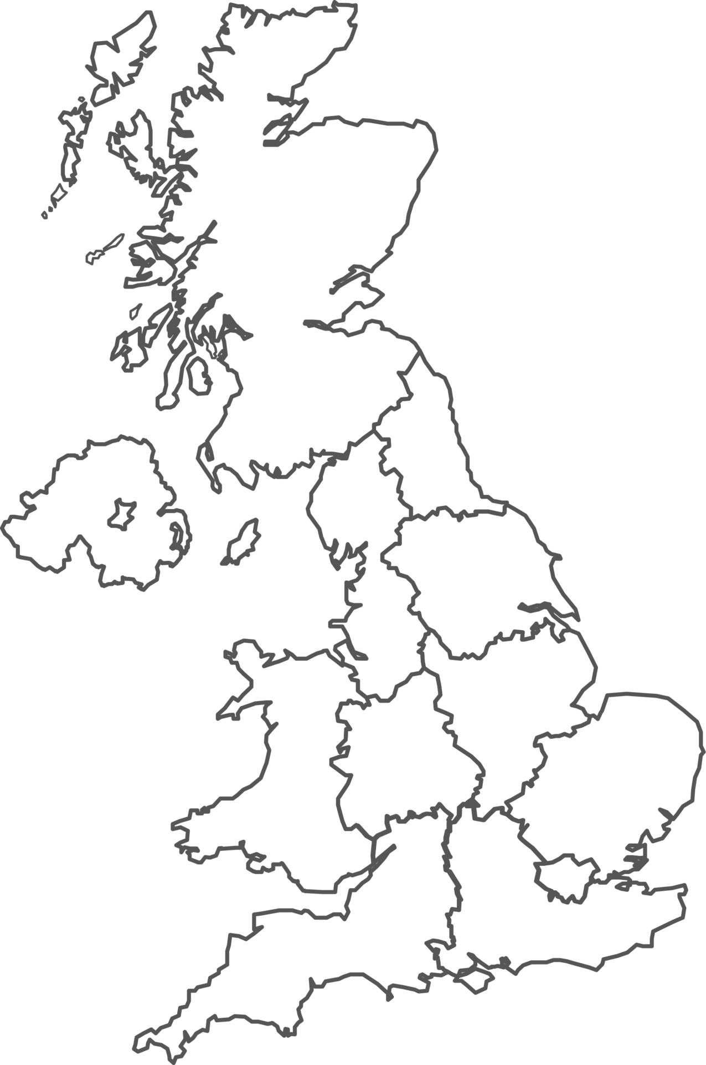
Clusters
Region (GB) | *Rated IT load (MW, 2024)
London | 1,048
Wales | 154
South East | 128
South West | 53
North West | 52
East | 44
Scotland | 30
North East | 17
Yorkshire and the Humber | 16
West Midlands | 15
East Midlands | 9
Total | 1.6 GW = 2%
AI Growth Zone
500 MW power capacity by 2030
Water to support 500 MW
Minimum 40.5 hectares or 60 football pitches
Existing data centre cluster
Proposed Hyperscale centre
Scotland Zone
Chapelhall
North Lanarkshire
Chapelcross
Annan
Dumfries and Galloway
North East England Zone
Cobalt Park, Newcastle
Cambois/Blyth, Northumberland
Elsham Tech Park
Elsham
North Lincolnshire
London clusters
Slough, West London (M4)
and Docklands
North Wales Zone
Prosperity Parc, Anglesey
Trawsfynydd, Gwynedd
South Wales Zone
M4 Corridor, Newport
- Bridgend, Glamorgan
South East England Zone
Culham, Oxfordshire
Notes:
AI Growth Zones: open for applications, Department for Science, Innovation & Technology (2025): applications welcomed from both local government and industry. Criteria for applying: Technical feasibility (Power availability of at least 500MW of power capacity by 2030, water availability to support at least 500MW of AI infrastructure and discharge, land availability of a minimum of 100 acres by 2028, Planning, Connectivity); Delivery feasibility; Local impact (Economic, Low-carbon energy sources); Level of government support requested (regulatory flexibility, planning assistance, coordination with agencies, relating to specific barriers, timeline if addressed) https://www.gov.uk/government/publications/ai-growth-zones/ai-growth-zones-open-for-applications
AI Growth Zones, Department for Science, Innovation & Technology (2025): names AI Growth Zones https://www.gov.uk/government/collections/ai-growth-zones
*Estimate of Data Centre Capacity: Great Britain 2024, Department for Science, Innovation & Technology (2025): Estimates 1.6 GW capacity for co-located data centres only (used by multiple businesses) and only measuring ‘rated IT load’, which measures IT equipment only. This is equivalent of more than 2% of national electricity demand https://www.gov.uk/government/publications/estimate-of-data-centre-capacity-great-britain-2024/estimate-of-data-centre-capacity-great-britain-2024
Foundations For The Future: How Data Centres Can Supercharge UK Economic Growth, techUK (2024): says Greater London, particularly Slough, is current data centre hub, but also highlight Manchester and South Wales as key growth areas. Also makes a calculation that 583 could be built on 'undeveloped' city region land to total of 350,052 MW, or 29,000 hectares techUK Report - Foundations For The Future: How Data Centres Can Supercharge UK Economic Growth
**Analysis: CO2 from UK data centres could be ‘hundreds of times’ higher than thought, Carbon Brief (2026): Highlights Ofgem data suggesting full commitment to 71 new data centres (20GW) and 140 more (50GW) likely to be approved. Claims this huge increase in demand for electricity will mean demand will have to be met by gas. Includes 37 GW calculation for UK electricity demand in 2025 https://www.carbonbrief.org/analysis-co2-from-uk-data-centres-could-be-hundreds-of-times-higher-than-thought/

Slide 13
Clusters
Region (GB) | **Electricity consumption (TWh, 2024) | % of data centre electricity consumption | % of local electricity consumption
South East | 1.8 | 40% | 5%
Slough | 1.3 | 29% | 65%
Hampshire | 0.2 | 4% | 5%
London | 1.7 | 37% | 5%
Hillingdon | 0.5 | 11% | 28%
Tower Hamlets | 0.4 | 9% | 18%
South West & Wales | 0.4 | 9% | 1%
East | 0.3 | 7% | 1%
South East & London | 3.5 | 77% | 1.4%
GB excluding London & South East | 1 | 23% | 0.4%
Total data centre electricity consumption | 4.5 |  | = 2%
Total electricity consumption | 249.2
Notes:
**Data centre electricity consumption in Great Britain, 2020 – 2024, Department for Energy Security and Net Zero (DESNZ)(2026): estimates total annual electricity consumption from the grid by data centres in Great Britain (excluding NI) from 2020 to 2024. Acknowledges no definition of data centre, and highlights this analysis covers only those servicing external organisations to the company that owns that data centre, including: colocation, managed, hyperscale, excluding enterprise systems. This saw 259 sites analysed, but 17 were excluded from the analysis as meters couldn’t be matched to the address. The researchers compiled a list of data centres from various sources and matched to meter level consumption. Combined, the South East and London represent 77% of data electricity consumption from the grid. Slough is effectively the third-largest consumer, where two-thirds of its local electricity consumption was from data centres, and consumption has double since 2020. This is attributed to the building of new data centres. Hillingdon in London has seen a five-fold increase in electricity consumption since 2020, attributed to growing electricity use from data centres that already existed in 2020. Tower Hamlets has seen a 5% decrease in data centre electricity consumption over this time and its Docklands area was noted as the space where data centres are clustered. https://assets.publishing.service.gov.uk/media/6a3e9f25da47783d87723bf2/Data_centre_electricity_consumption_in_Great_Britain__2020_to_2024.pdf
This research highlight two further studies making equivalent estimates.
Future Energy Scenarios: Pathways to Net Zero, National Energy System Operator (2025): estimates current demand from data centres at 7.6 TWh per year or 2.4 GW total demand based on estimated capacity and highlights that this could increase to 20 to 41 TWh by 2035 and 30 to 71 TWh by 2050. The 2026 study got a much lower figure https://www.neso.energy/document/364541/download
2) Non-domestic National Energy Efficiency Data-Framework (ND-NEED), Department for Energy Security and Net Zero and Department for Business, Energy & Industrial Strategy (2025): this study got a figure of 2.6 TWh for electricity consumption of data centres in England and Wales in 2023 by using an algorithm to identify relevant non-domestic buildings via HMRC data and matching to meter consumption. The 2026 study got a higher figure of 4.1 TWh for England and Wales https://www.gov.uk/government/statistics/non-domestic-national-energy-efficiency-data-framework-nd-need-2025

Slide 14
New sites?
71 new data centres, 20 GW capacity with funding approved and stakeholders engaged (Ofgem, February 2026)
140 new data centres, 50 GW capacity likely to be approved if they demonstrate they are ready to connect to the grid and are aligned with government’s strategic aims including Clean Power 2030 Action Plan (Ofgem, February 2026)
Elsham Tech Park in North Lincolnshire (not AI Growth Zone): 1 GW capacity, 176 hectares, £7.5bn, scheduled for build from 2027 to open 2029, 2,600 and 3,600 full-time construction jobs per year, “largest AI data centre campus in the UK”.
Chapelcross AI Data Centre in Dumfries and Galloway (not AI Growth Zone): 1 GW capacity, £16.5 bn, scheduled for eight-year build, water use of “32 households”, energy use of “two million homes”, around 500 jobs and/or 750 construction jobs, “'world's largest' data centre”.
Notes:
Ofgem Demand Connection Reform: consultation, Ofgem (2026): identifies 71 new data centres representing 20 GW total demand as FDI, plus 140 data centres representing 50 GW likely to receive Gate 2 approval where they get a date to be connected. The UK's total energy demand was 37 GW in 2025 (Carbon Brief, 2026). https://www.ofgem.gov.uk/call-for-input/demand-connections-reform
AI data centres in the UK, Royal Geographical Society (2026): briefing on 'AI data centres' that summarises the build at Elsham https://www.rgs.org/schools/resources-for-schools/ai-data-centres-uk
Plans submitted for 'world's largest' data centre at former nuclear power station, STV (2026) https://news.stv.tv/west-central/plans-submitted-for-worlds-largest-data-centre-at-former-chapelcross-nuclear-power-station

Slide 15
Estimates: UK
England and Wales electricity consumption of data centres in 2023 (2025) | 2.6 TWh | ND-NEED
Great Britain rated IT load of data centres in 2024 (2025) | 1.6 GW | DSIT
Great Britain electricity consumption of data centres in 2024 (2026) | 4.5 TWh | DESNZ
Great Britain electricity consumption of data centres in 2025 (2025) | 7.6 TWh = 2.4 GW | NESO
Forecast GB electricity consumption of data centres by 2035 (2025) | 20-41 TWh | NESO
Forecast GB electricity consumption of data centres by 2050 (2025) | 30-71 TWh | NESO
English data centres (of 73 surveyed) using waterless cooling systems (2025) | 51% | techUK
English data centres (of 73 surveyed) using less than 10,000 m³ of water a year – “less than a typical leisure centre”, equivalent to 10 million litres (2025) | 64% | techUK
English data centres (of 73 surveyed) that either measure water use or use systems that do not need water for cooling (2025) | 89% | techUK
Proposed UK data centres in areas projected to be water stressed by 2040 (2026) | 84% | Global Action Plan
Notes:
Non-domestic National Energy Efficiency Data-Framework (ND-NEED), Department for Energy Security and Net Zero and Department for Business, Energy & Industrial Strategy (2025)
Estimate of Data Centre Capacity: Great Britain 2024, Department for Science, Innovation & Technology (2025)
Data centre electricity consumption in Great Britain, 2020 – 2024, Department for Energy Security and Net Zero (DESNZ)(2026)
Future Energy Scenarios: Pathways to Net Zero, National Energy System Operator (NESO)(2025) https://www.neso.energy/document/364541/download
Analysis: UK renewables enjoy record year in 2025 – but gas power still rises, Carbon Brief (2026): calculates UK average electricity demand is 332 TWh, which is equivalent to 37 GW. Renewables supplied 47% of electricity and this was the first year without coal. Nuclear lowest in 50 years due to refuelling or outages, meaning gas for electricity was up 5% to 28%. Energy demand also increased 1% https://www.carbonbrief.org/analysis-uk-renewables-enjoy-record-year-in-2025-but-gas-power-still-rises/
Understanding data centre water use in England, techUK (2025): full report not accessible but they say of 73 English data centres surveyed, 51% use waterless cooling systems, 64% use less than 10,000 m³ of water per year – "less than a typical leisure centre", 89% either measure water use or use systems that do not need water for cooling. 10,000 m³ represents 10 million litres each https://www.techuk.org/resource/techuk-report-understanding-data-centre-water-use-in-england.html
Not a drop to drink: How Britain’s data centre surge threatens water security, Global Action Plan (2026): report on water use by data centres by UK charity, figure derived from open data sources on water stress from the Environment Agency https://www.globalactionplan.org.uk/files/not_a_drop_to_drink_-_april_2026.pdf

Slide 16
Estimates: global
Global energy consumption of data centres in 2023, excluding crypto (2025) | 300-380 TWh | IEA, 4E, TCP
Amazon, Alphabet, Microsoft, Meta data centre energy consumption in 2023 (2025) | 90 TWh | IEA, 4E, TCP
Global electricity consumption of data centres in 2024 (2025) | 415 TWh | IEA
Global electricity consumption of data centres, % of electricity in 2024 (2025) | 1.5% | IEA
Growth in electricity consumption of data centres per year for past 5 years (2025) | 12% | IEA
Forecast global electricity consumption of data centres by 2030 (2025) | 945 TWh | IEA
Forecast global energy consumption of AI by 2030 (2025) | 200-400 TWh | IEA, 4E, TCP
Global estimate of data centre water use in litres (2025) | 560 billion | IEA
Global estimate of data centre water use in litres by 2030 (2025) | 1.2 trillion | IEA
Notes:
Energy and AI, International Energy Agency (2025): highlights that knowing future requirements is key for managing future energy demand https://iea.blob.core.windows.net/assets/de9dea13-b07d-42c5-a398-d1b3ae17d866/EnergyandAI.pdf
Data Centre Energy Use: Critical Review of Models and Results, International Energy Agency's Technology Collaboration Programme on Energy Efficient End-Use Equipment (4E TCP) (2025): Literature review of studies trying to measure the energy use of data centres. Highlights a few UK sources of estimates including NESO. Highlights that AI is driving energy consumption and analyses literature estimating energy us of AI https://www.iea-4e.org/wp-content/uploads/2025/05/Data-Centre-Energy-Use-Critical-Review-of-Models-and-Results.pdf

Slide 17
Estimates: equipment
Electricity
Estimated electricity demand for servers | ~60% | IEA
Estimated electricity demand for storage | ~5% | IEA
Estimated electricity demand for networking equipment (e.g. routers) | ~5% | IEA
Estimated electricity demand for HVAC (efficient hyperscale to less efficient enterprise) | ~7-30% | IEA
Water
Estimated water use for energy supply and electricity generation | ~66% | IEA
Estimated water use for equipment cooling | ~25% | IEA
Estimated water use for semiconductor and microchip manufacturing | ~9% | IEA
Notes:
Energy and AI, International Energy Agency (2025): highlights that knowing future requirements is key for managing future energy demand https://iea.blob.core.windows.net/assets/de9dea13-b07d-42c5-a398-d1b3ae17d866/EnergyandAI.pdf

Slide 18
Defining data centres
Data centres are large electrical computing systems that are used to process and store information. They require land, power, and heating, ventilation and cooling (HVAC) systems to control their temperature.
Data centres may be categorised by what they are used for (e.g. enterprise use only) or be placed in particular locations for specific reasons, such as to be close to other sites so work can be offloaded if one site fails.
They are a government priority because of innovation policies that are geared for economic growth, which are changing the UK’s approach to local planning, and due to national security concerns about to their widespread and growing use for processing data for public and consumer services. The extent of their current and potential environmental and social harms has been less clearly considered.
Notes:
Protecting and enhancing the security and resilience of UK data infrastructure, Department for Science, Innovation & Technology (2024): includes definitions of data centres: colocation (used by multiple businesses), cloud or hyperscale (run by cloud company for cloud services), managed service (provides managed service), enterprise and on-premises (for a particular business), network operator (for telecoms and internet). Also highlights: regional (large serving entire regions or near major urban areas), edge (micro and close to users), modular (portable) https://www.gov.uk/government/consultations/protecting-and-enhancing-the-security-and-resilience-of-uk-data-infrastructure
Data centres: planning policy, sustainability, and resilience, House of Commons Library (2025): Defines data centres by use (enterprise, co-location, hyperscale and AI) and need: latency (speed, near to customers), availability (to make use of another centre if one fails, in Availability Zones advised to be 8km apart each) and energy intensive (for AI training, location to energy supply most important). Defines data centres via use, including availability, latency and energy intensity https://researchbriefings.files.parliament.uk/documents/CBP-10315/CBP-10315.pdf

Slide 19
Measuring data centres
Size: total site or computing system, acres, sqm etc
MW: total power generated or used, typically used in computing industry to refer to electricity only
MWh: actual power generated or used over a given time, typically used in energy industry to refer to electricity
MWth: total heat generated or used, used in environmental permitting to calculate whether the backup generators needed to power a data centre mean it is designated a ‘combustion plant’
KW, GW, GWh, TW, TWh (smaller or larger units, latter used to avoid long numbers)
Including or excluding non-computing system infrastructure e.g. heating and cooling

Slide 20
Case study: Google
SIC: 82990 - Other business support service activities not elsewhere classified.
Google Waltham Cross is Google’s first owned data centre site, though it is being managed through a subsidiary called Global Infrastructure UK Limited.
Site is 13 hectares (20 football pitches) and cost £790m of a £5bn planned investment, including planned heat reuse network.
Data centre size can be found as more than 50MWth via an environmental permit for the backup power generators.
It is being powered ‘by renewables’ via a Power Purchase Agreement with French-Spanish joint venture Scottish offshore wind project ENGIE, also powering Amazon’s UK data centres.
Now partnered with Shell to manage energy use and battery storage.
Borders Lee Valley Regional Park, which has many areas under legal protection.
Data centres operators including Google are using ISO 50001 and other standards to evidence their energy management and resource use.

Slide 21
Case study: Vantage
SIC: 62090 - Other information technology service activities.
Says it is Europe's largest campus and has three, three-floor data centres, plus one newer building.
Newport location means it is effectively in at AI Growth Zone and site is leased from Welsh government.
Site is 19 hectares (29 football pitches), 148MW total power needed for three data centres, with 520MWth backup diesel generators.
'Unique' supergrid connection bypassing substations, meaning it is powered by electricity.
Say they signed the first Climate Change Agreement (CCA) for Data Centres, a discount on Climate Change Levy administered by Environment Agency.
Generators will emit sound at a level that is harmful to human hearing (103 dBA).
Notes:
Climate Change Agreements (CCA) for Data Centres, techUK (2023): overview of the Climate Change Agreement system for data centres where they can get a discount on the Climate Change Levy if they can show they are meeting targets for energy efficiency. DESNEZ set an energy improvement target for the data centres sector of 14.5% relative to a 2022 baseline by the end of 2030, opening on 1 January 2026 https://www.techuk.org/resource/climate-change-agreements-cca-for-data-centres.html

Slide 22
A full glossary must include
Descriptions of standard units of measurement, and how matter and energy behave (e.g. litres, decibels, power)
Generic and industry-specific computing terms used to describe and explain activities (e.g. CPUs, servers)
Terms used by other industries to describe how these systems operates (e.g. energy demand)
Terms used by government across different areas to name particular issues and ideas (e.g. AI Growth Zones)

Slide 23
What is a data centre anyway?
8th October 2026 - Dr Kirsty Styles

